Slide 1
Machine Learning in Business John C. Hull
Chapter 5
Supervised Learning: SVMs

Slide 2
A Baby Example (We carry out an approximate scaling by subtracting 620 from the credit score) Table 5.1
Credit score | Adjusted credit score | Income (‘000s) | Default =0; good loan=1
660 | 40 | 30 | 0
650 | 30 | 55 | 0
650 | 30 | 63 | 0
700 | 80 | 35 | 0
720 | 100 | 28 | 0
650 | 30 | 140 | 1
650 | 30 | 100 | 1
710 | 90 | 95 | 1
740 | 120 | 64 | 1
770 | 150 | 63 | 1

Slide 3
Linear Separation (circles are defaulting loans, squares are good loans) Figure 5.1

Slide 4
SVM Approach
In the support vector machine (SVM) approach we find a pathway that separates the data into two classes as far as possible
In the “hard margin” case perfect separation is possible (as in our example)
The algorithm finds the widest path possible
Data must be normalized. (We carry out approximate normalization by subtracting 620 from credit score)
The support vectors are the observations at the edge of the pathway

Slide 5
Best pathway for example. Solid line would be used to distinguish good and bad loans

Slide 6
Notation (Figure 5.3)

Slide 7
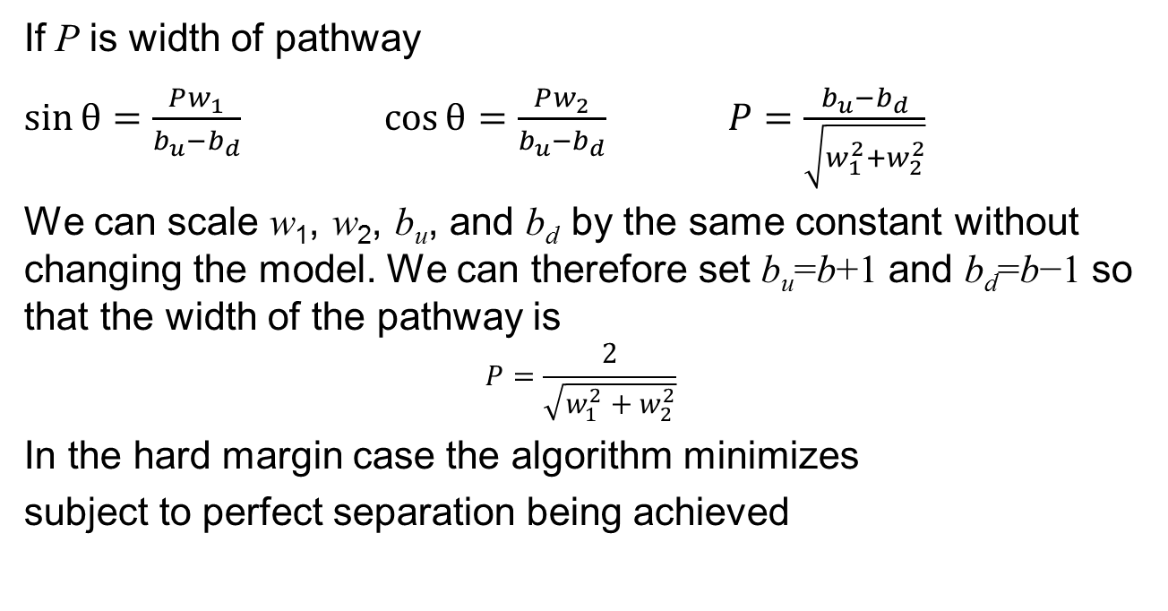
The Math
If P is width of pathway
$\sin{θ}=\frac{Pw_{1}}{b_{u}−b_{d}}$ $\cos{θ}=\frac{Pw_{2}}{b_{u}−b_{d}}$ $P=\frac{b_{u}−b_{d}}{\sqrt{w_{1}^{2}+w_{2}^{2}}}$
We can scale w₁, w₂, b_{u}, and b_{d} by the same constant without changing the model. We can therefore set b_{u}=b+1 and b_{d}=b−1 so that the width of the pathway is
$$P=\frac{2}{\sqrt{w_{1}^{2}+w_{2}^{2}}}$$
In the hard margin case the algorithm minimizes
subject to perfect separation being achieved

Slide 8
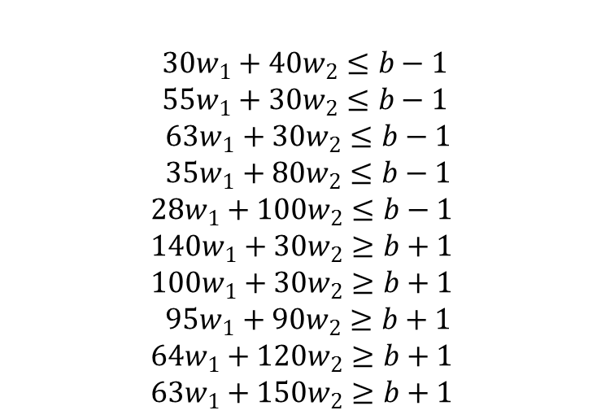
Specification of hard margin problem for baby data
In our example the task is to find b, w₁, and w₂ to minimize
subject to
$$30w_{1}+40w_{2}≤b−1$$
$$55w_{1}+30w_{2}≤b−1$$
$$63w_{1}+30w_{2}≤b−1$$
$$35w_{1}+80w_{2}≤b−1$$
$$28w_{1}+100w_{2}≤b−1$$
$$140w_{1}+30w_{2}≥b+1$$
$$100w_{1}+30w_{2}≥b+1$$
$$95w_{1}+90w_{2}≥b+1$$
$$64w_{1}+120w_{2}≥b+1$$
$$63w_{1}+150w_{2}≥b+1$$

Slide 9
The general hard margin problem
The objective function is
We minimize this for values of w_{i} and b subject to the condition that there are no violations, i.e.:

Slide 10
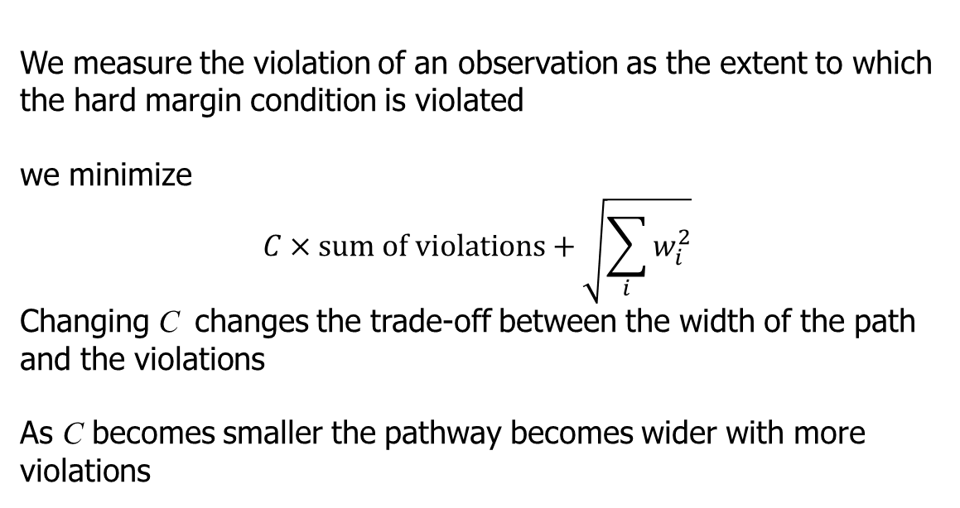
The Soft Margin Problem
We measure the violation of an observation as the extent to which the hard margin condition is violated
we minimize
$$C×sum of violations+\sqrt{\sum_{i}{w_{i}^{2}}}$$
Changing C changes the trade-off between the width of the path and the violations
As C becomes smaller the pathway becomes wider with more violations

Slide 11
Changed example:
Credit score | Adjusted credit score | Income (‘000s) | Default =0; good loan=1
660 | 40 | 30 | 0
650 | 140 | 55 | 0
650 | 30 | 63 | 0
700 | 80 | 35 | 0
720 | 100 | 28 | 0
650 | 30 | 140 | 1
650 | 30 | 100 | 1
710 | 90 | 60 | 1
740 | 120 | 64 | 1
770 | 150 | 63 | 1

Slide 12
C=0.001 Results

Slide 13
Impact of C for Example
C | w₁ | w₂ | b | Loans mis-classified | Width of pathway
0.01 | 0.054 | 0.022 | 5.05 | 10% | 34.4
0.001 | 0.040 | 0.012 | 3.33 | 10% | 48.2
0.0005 | 0.026 | 0.010 | 2.46 | 10% | 70.6
0.0003 | 0.019 | 0.006 | 1.79 | 20% | 102.2
0.0002 | 0.018 | 0.003 | 1.69 | 30% | 106.6

Slide 14
Non-linear separation (Figure 5.5)

Slide 15
Non-linear classification
The objective is to create new features so that the boundary becomes linear
Suppose there is a single feature (age?) and we find the low and high values of the feature tend to give one outcome while intermediate values give another outcome
We could form a new feature as (v-m)² where v is the feature value and m is its mean

Slide 16
Forming new features
We can add powers of each feature as a new feature.
Alternatively, we can choose particular landmarks and create new features using the Gaussian Radial Basis Function (a similarity function). If values of features at a landmark are ℓ₁, ℓ_{2,} ……, ℓ_{m}, the new feature values are calculated as
As the parameter γ increases the span of influence of a landmark decreases and the boundary becomes less smooth

Slide 17
SVM Regression: using SVM to predict a continuous variable
We search for a pathway with a certain width that includes as many target values as possible
If a target value lies within the pathway there is assumed to be no error
If it lies outside the pathway the error is the difference between the actual value and the value predicted by the outer edge of the pathway

Slide 18
The Single Feature Case
Observation
Error

Slide 19
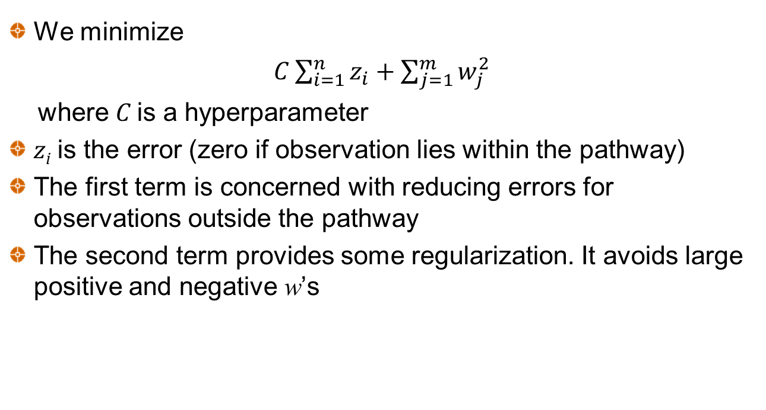
General Case
We minimize
$C\sum_{i=1}^{n}{z_{i}}+\sum_{j=1}^{m}{w_{j}^{2}}$
where C is a hyperparameter
z_{i} is the error (zero if observation lies within the pathway)
The first term is concerned with reducing errors for observations outside the pathway
The second term provides some regularization. It avoids large positive and negative w’s

Slide 20
Predicting Iowa House Prices from Living Area when e=50,000 and C=0.01 (Figure 5.7)

Slide 21
Predicting Iowa House Prices from Living Area when e=100,000 and C=0.1 (Figure 5.8)

